Slide 1
R Company
Presents

Slide 2
Cruise of the Year
Get away from your problems
Seven day total
Greatest value for your money
See the Hula Girls
Why drive?
Why drive?

Slide 3
U.S.A.
Don’t type this data in presentation.
Use the following data to create the char above.
 | 1st Qtr | 2nd Qtr | 3rd Qtr | 4th Qtr
East | 20.4 | 27.4 | 90 | 20.4
West | 30.6 | 38.6 | 34.6 | 31.6
North | 45.9 | 46.9 | 45 | 43.9
Classes at
822 Robertson Blvd.
Los Angeles
Frank N. Stein

Slide 4
Lovely Hula Hands
The first time
I stepped off
that plane and
saw real hula girls
in grass skirts,
Hawaii,1959.
Frank N. Stein

Slide 5
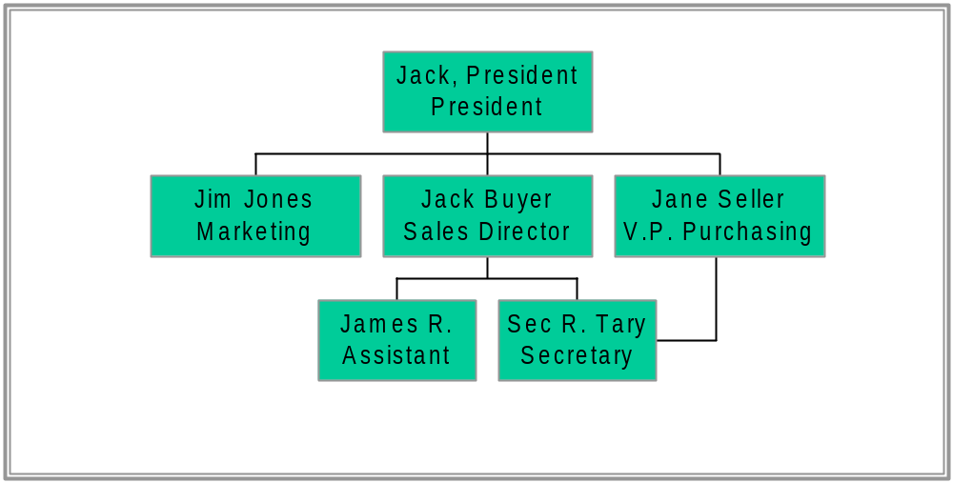
R. Com. Pany. Inc.

Slide 6
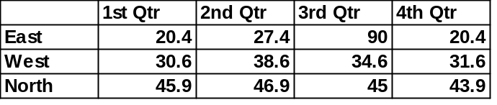
Cost Analysis
Point out financial benefits to the customer
Compare cost-benefits between you and your competitors
Use the following data to create the chart:

